Slide 1
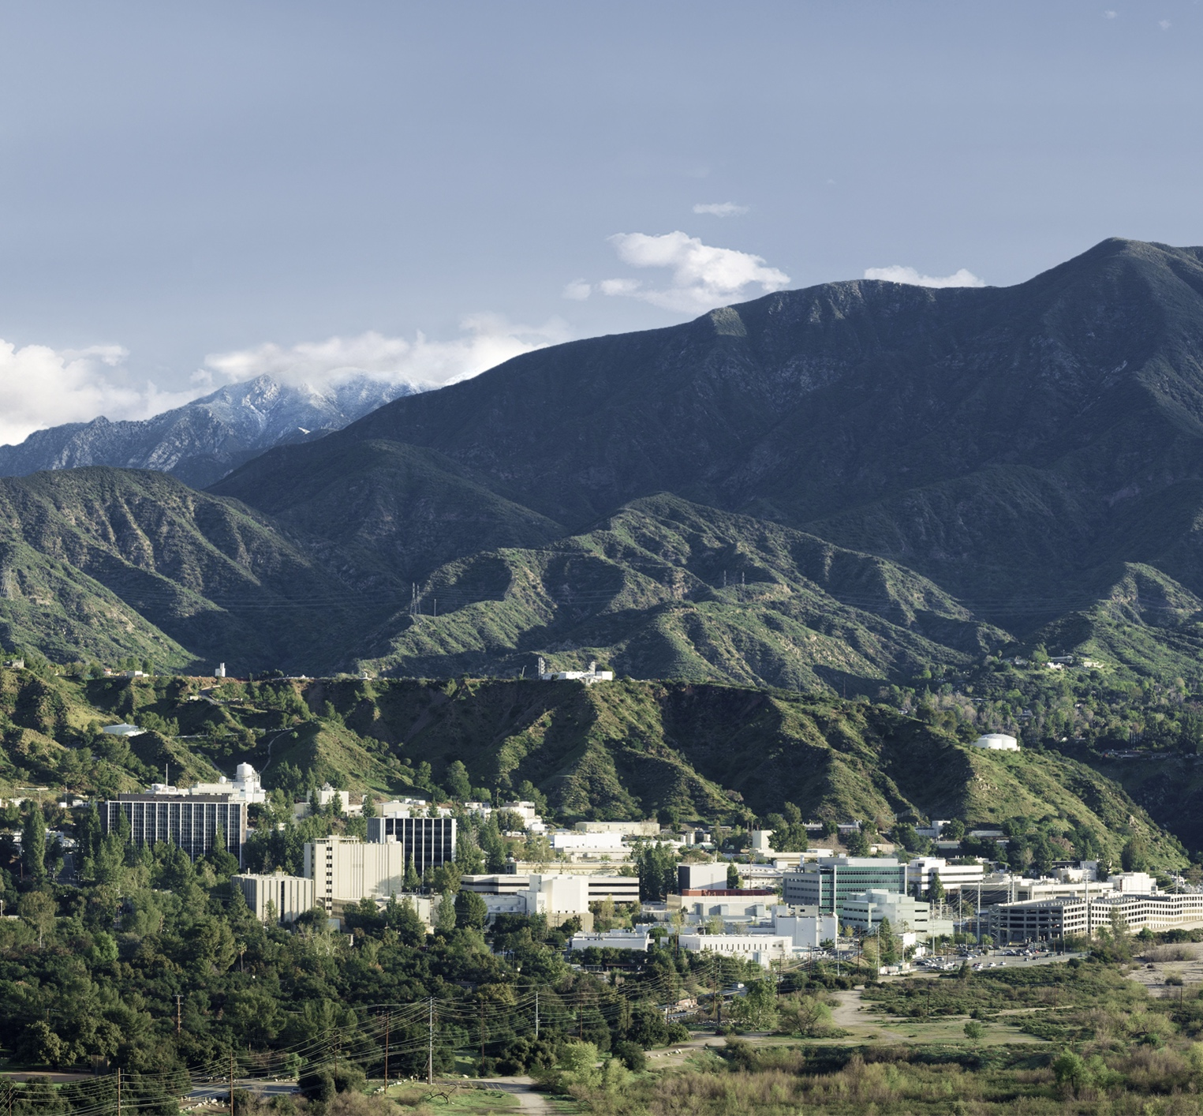
Reference herein to any specific commercial product, process, or service by trade name, trademark, manufacturer, or otherwise, does not constitute or imply its endorsement by the United States Government or the Jet Propulsion Laboratory, California Institute of Technology.
Tika 2.x
Robustness and Scale
ApacheCon At Home 2021
Tim Allison, Ph.D.
Data Scientist/Relevance Engineer
Artificial Intelligence, Analytics and Innovative Development Organization(1740)
ITSD
﻿The research was carried out at the NASA (National Aeronautics and Space Administration) Jet Propulsion Laboratory, California Institute of Technology under a contract with the Defense Advanced Research Projects Agency (DARPA) SafeDocs program. © 2021 California Institute of Technology. Government sponsorship acknowledged.

Slide 2

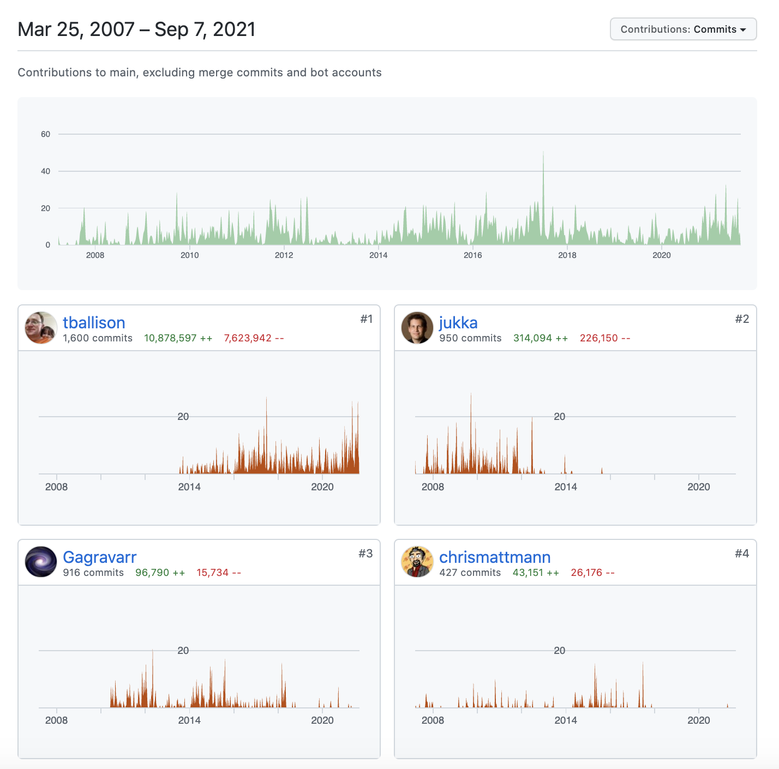
About me
Data Scientist/Relevance Engineer, Jet Propulsion Laboratory, California Institute of Technology
Chair/V.P. Apache Tika
Committer/PMC Apache PDFBox
Committer/PMC Apache POI
Committer Apache Lucene/Solr, OpenNLP
Member ASF
Ph.D. Classical Studies

Slide 3




Apache Tika, an overview
text and metadata
Framework for file type detection, parsing and uniform output for ~75 parsers, ~100+ formats
https://tika.apache.org/
bytes

Slide 4
Apache Tika, features
Easy to add new file types for detection
Easy to add new parsers
Works recursively with embedded files/attachments
Integration with tesseract-ocr

Slide 5
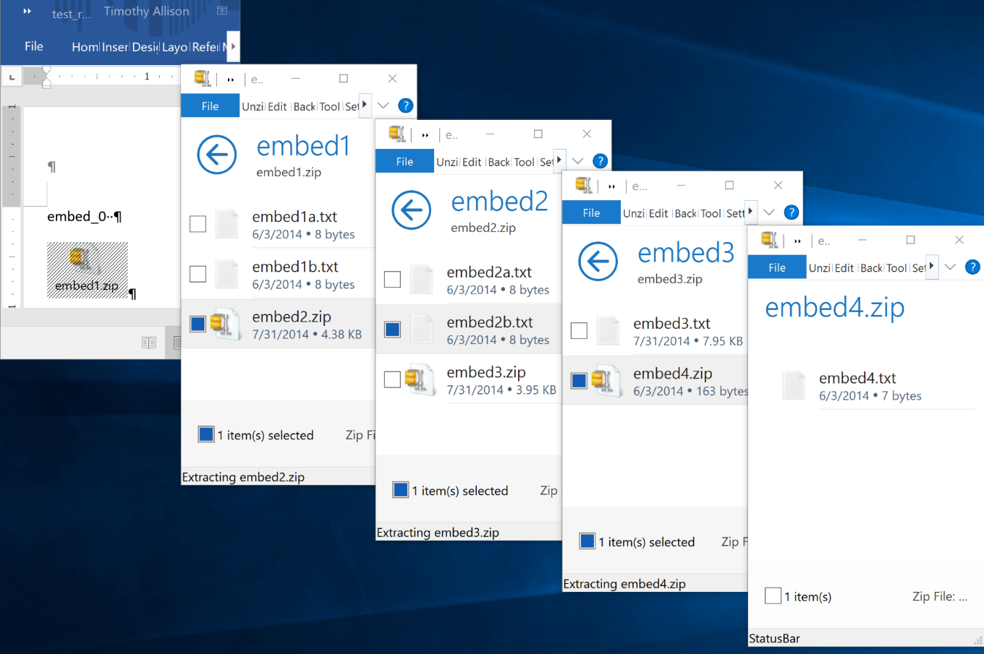
Embedded files/attachments

Slide 6
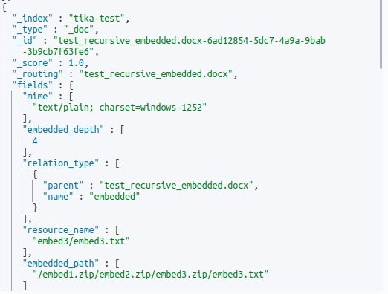
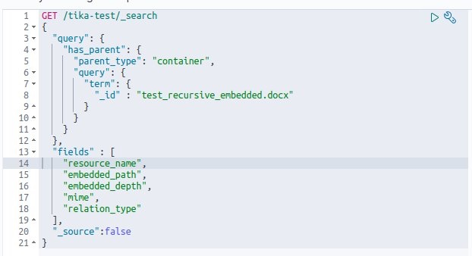
Parent/Child in OpenSearch

Slide 7
Outline
Status
2.x highlights - maven modularization
Motivations for tika-pipes
Crashing JVMs at scale
Brief history of tika-server
tika-pipes

Slide 8
Status
Tika 2.0.0-ALPHA released January 2021.
Tika 2.0.0-BETA released May 2021.
Tika 2.0.0 released July 2021.
Tika 2.1.0 released August 2021.

Slide 9
Maven Modularize All the Things
© 2021 California Institute of Technology. Government sponsorship acknowledged.

Slide 10
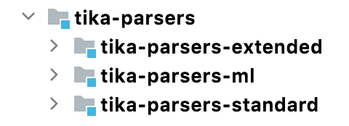
tika-parsers
tika-parsers-standard
tika-parsers-extended
May require heavy dependencies, parsers that require external resources (network calls), parsers that require native libs (e.g. sqlite3)
tika-parsers-ml
Super heavy dependencies (dl4j)
Heavy processing beyond “text from bytes” (image recognition/NLP)

Slide 11
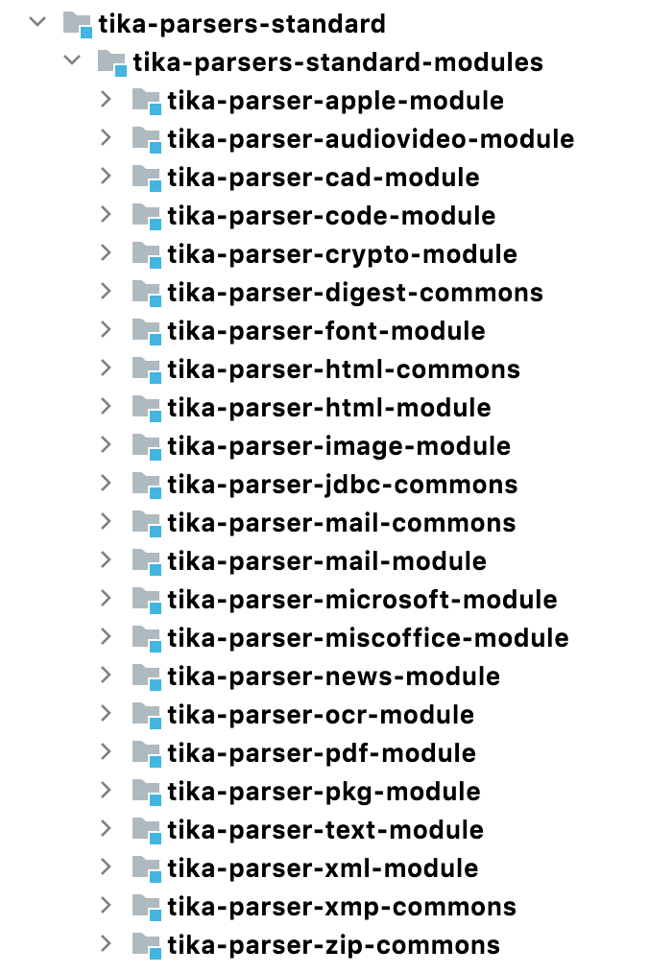
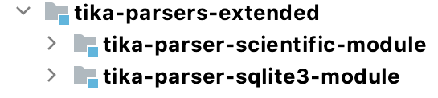
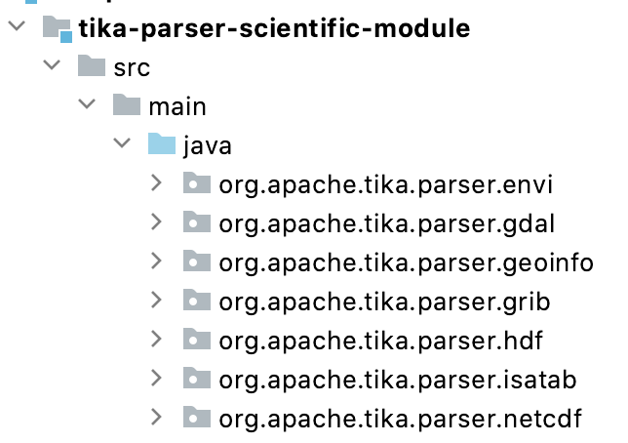
tika-parsers-standard and tika-parsers-extended

Slide 12
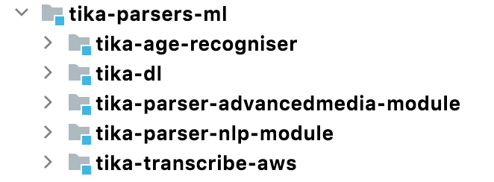
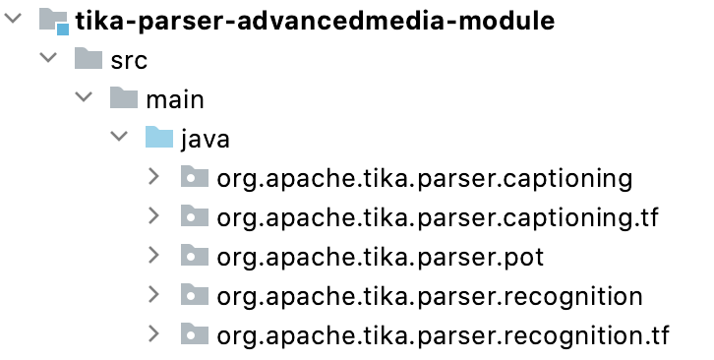
tika-parsers-ml
ASR/STT! Thanks to TIKA-94 and Lewis McGibbney and team!

Slide 13
tika-app and parser modules
Same as before but with only tika-parsers-standard included
Users must add tika-parsers-extended submodules for scientific format parsing and/or sqlite3 parsing

Slide 14
tika-server and parser modules
tika-server-core
Basic server with no parsers
tika-server-standard
Server with standard parser
Users must add tika-parsers-extended submodules for scientific format parsing and/or sqlite3 parsing

Slide 15
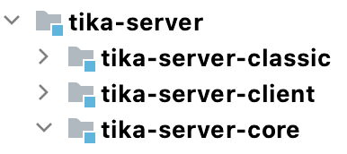
tika-server modularized

Slide 16
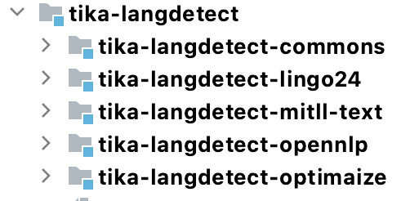
langdetect modularized

Slide 17
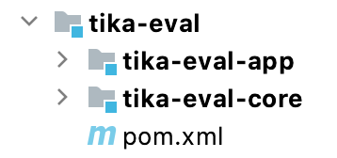
tika-eval modularized
 | Tika 1.14 | Tika 1.15-SNAPSHOT
Unique Tokens | 786 | 156
Total Tokens | 1603 | 272
LangId | zh-ch | de
Common Words | 0 | 116
Alphabetic Tokens | 1603 | 250
Top N Tokens | 捳敨: 18 | 獴档: 14 | 略獴: 14 | m: 11 | 杮湥: 11 | 瑵捳: 11 | 畬杮: 11 | 档湥: 10 | 搠敩: 9 | 敮浨: 9 | die: 11 | und: 8 | von: 8 | deutschen: 7 | deutsche: 6 | 1: 5 | das: 5 | der: 5 | finanzministerium: 5 | oder: 5
OOV% | 1-(0/1603) = 100% | 1-(116/250) = 54%
Drop tika-eval-core.jar on your classpath with tika-server and you’ll get tika-eval stats!

Slide 18
tika-eval’s Out-of-vocabulary (OOV) in action
Text As Stored in File
!"#%$& (') *,+-).' / 0 1,23 *. 457698;:;<>=75?&@78;ACB D(B7E;FHGJICBK5MLNBKOPBKF;B DJD Q R S.TVU9WNXMY[Z\T]^W_S `badc 5KICedFgfh5 cji :;edF;A^5KEk<>Imln:;e[<>EnloedACICe a lo<p57Eg5Kqsr;E;<jloe[E 8;O 6hedA5Kq adc 57ItedFk:;B c qsICf;B a
Text from Tesseract OCR
Constrained Least Squares Linear Spectral Unmixture by the Hybrid Steepest Descent Method
Nobuhiko Ogura’ and Isao Yamada”
1 Introduction
A closed polyhedron is the intersection of finite number of closed half spaces, i.e., the setof points satisfying finite number of lincar incqualitics, and is widely used as a constraint in various application, for example specifications or constraints in signal processing or estimation problems, resource restrictions in financial applications and feasible sets of

Slide 19
Crashing JVMs at Scale*
*Credit: Nick Burch
© 2021 California Institute of Technology. Government sponsorship acknowledged.

Slide 20
When bad things happen…
Out of memory errors
Infinite loops
Slow-building memory leaks
Crashes (System.exit) or OS oom-killer
Malicious code
Runaway forked processes

Slide 21
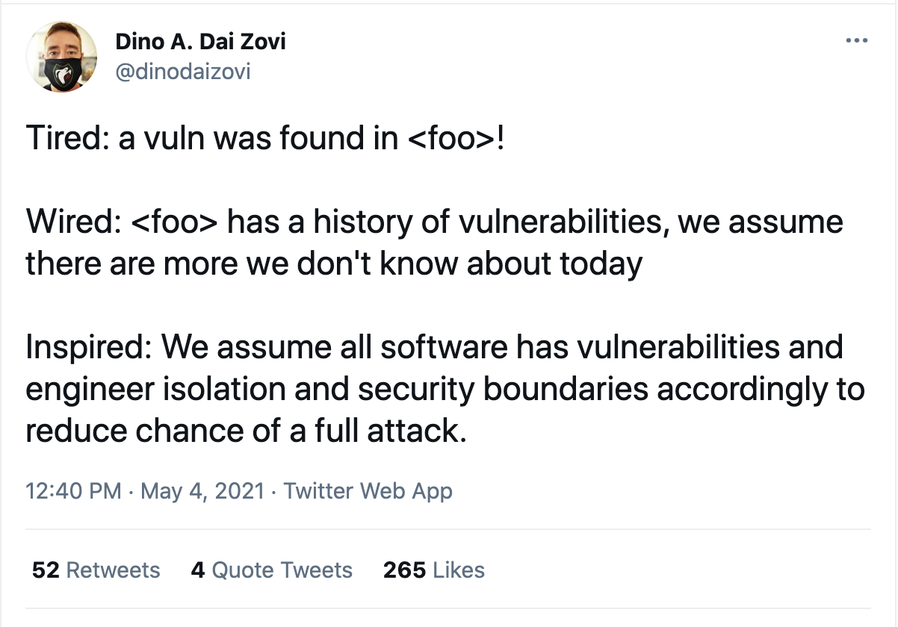
Tika is not alone!
https://twitter.com/dinodaizovi/status/1389620920789131266

Slide 22
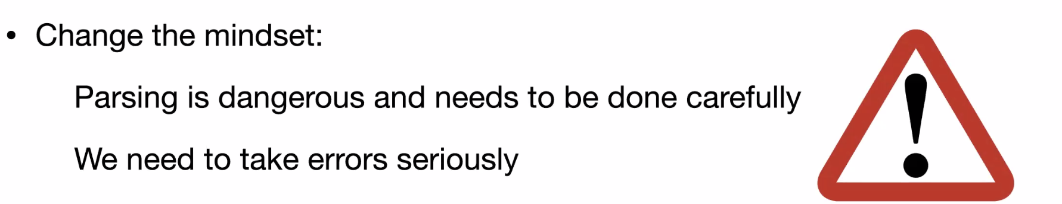
Parsing is dangerous!
“High-Assurance Input Validation: Locking the Front Door.”
Kathleen Fisher’s Keynote. LangSec 2021 Workshop. IEEE Security and Privacy.
https://langsec.org/spw21/slides/Fisher_LangSec21.pdf

Slide 23
Really, quite dangerous!
80% of CVEs are in code that handles input data
2020 CWE Top 25 most dangerous software weaknesses
#1 Improper neutralization of input during web page generation
#3 improper input validation
1000 parser bugs in Mozilla
“High-Assurance Input Validation: Locking the Front Door.” Kathleen Fisher’s Keynote. LangSec 2021 Workshop. IEEE Security and Privacy.
https://langsec.org/spw21/slides/Fisher_LangSec21.pdf

Slide 24
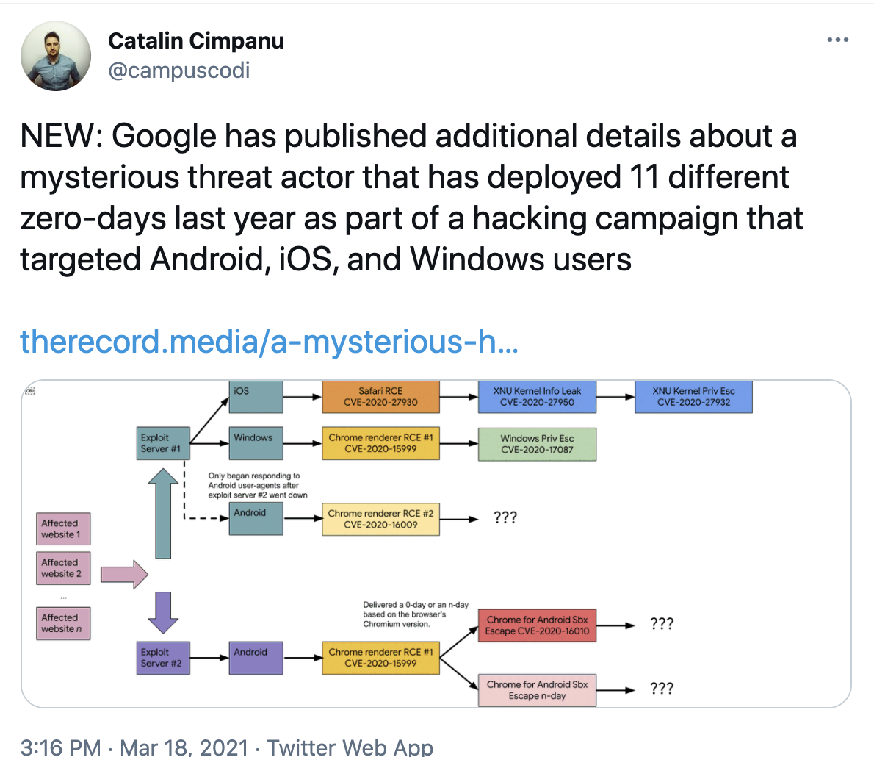
Font parsers as components of exploit chains
Four of these are font parsers!
CVE-2020-0938
CVE-2020-1020
CVE-2020-15999
CVE-2020-27930
https://twitter.com/campuscodi/status/1372628034679930886
https://therecord.media/a-mysterious-hacking-group-used-11-different-zero-days-in-2020

Slide 25
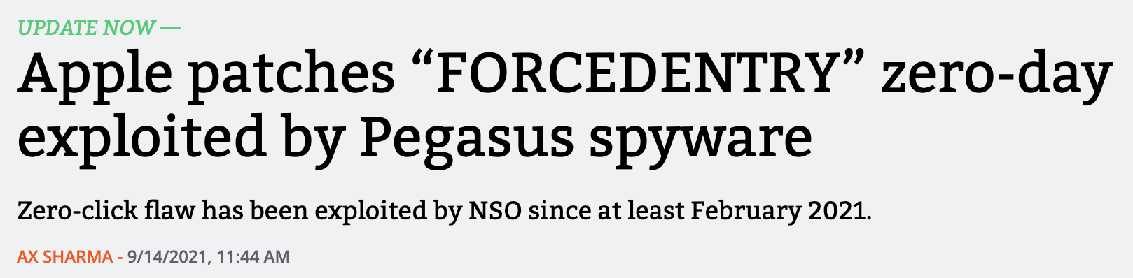
FORCEDENTRY
PSD, PDF, but actually JBIG2
https://arstechnica.com/information-technology/2021/09/apple-fixes-imessage-zero-day-exploited-by-pegasus-spyware/
https://objective-see.com/blog/blog_0x67.html

Slide 26
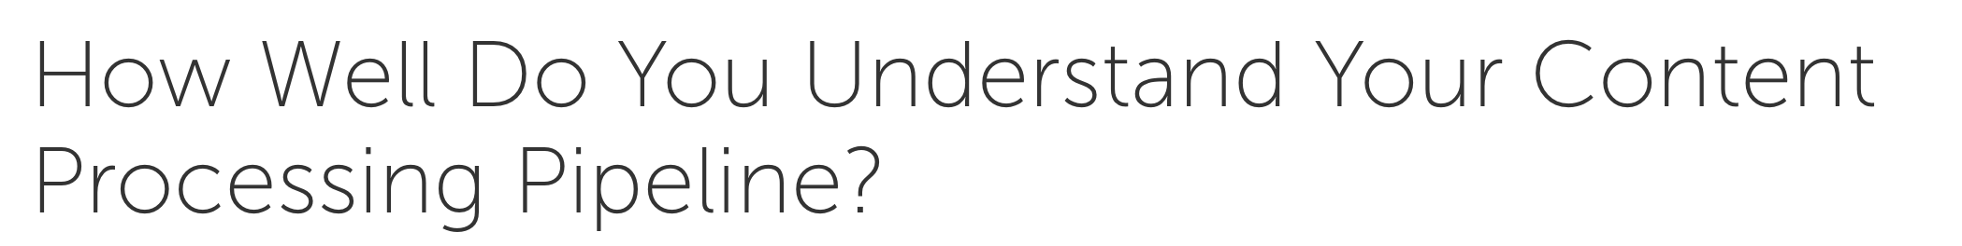
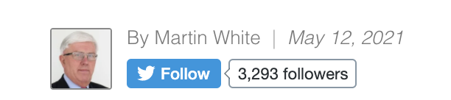
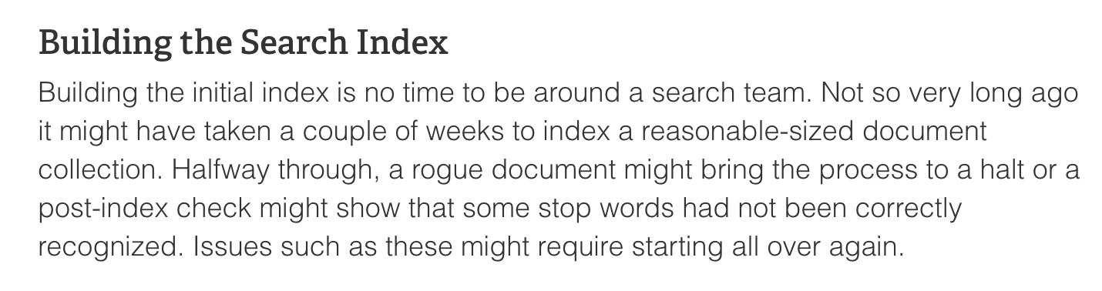
“Rogue” Documents
https://www.cmswire.com/knowledge-findability/how-well-do-you-understand-your-content-processing-pipeline/

Slide 27
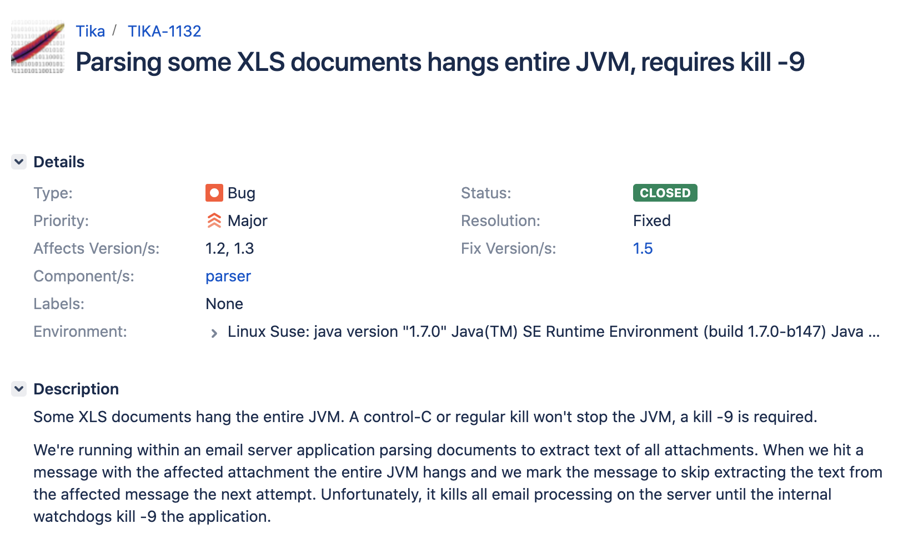
TIKA-1132

Slide 28
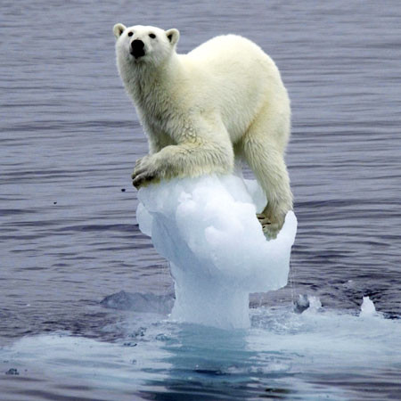
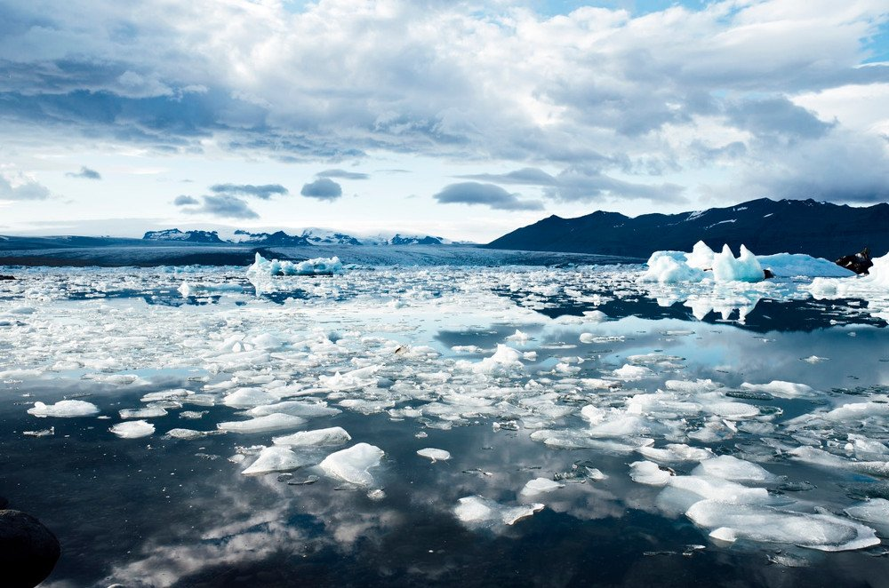
Are Infinite Loops Really that Bad?
https://www.scienceabc.com/eyeopeners/would-oceans-become-less-salty-if-all-the-polar-ice-caps-melted.html
https://metro.co.uk/2008/05/15/struggling-polar-bears-put-on-endangered-list-137306/

Slide 29
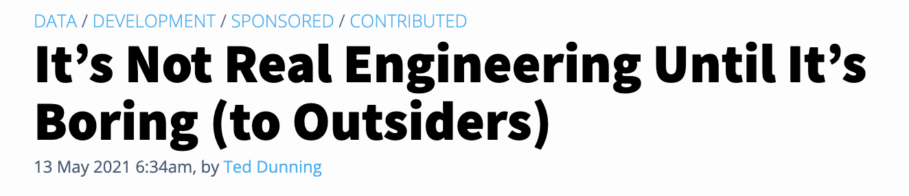
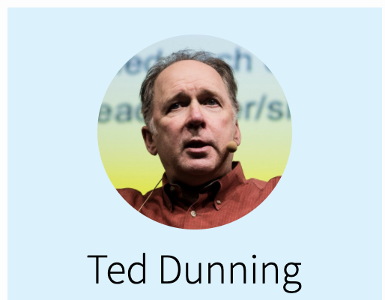
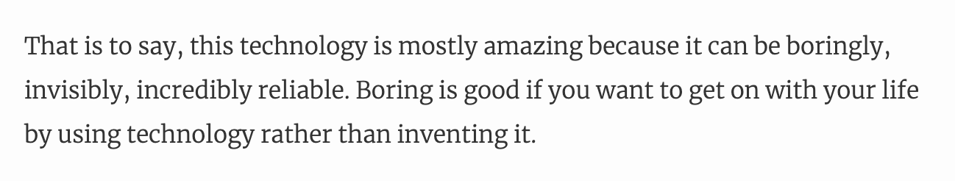
Overall goal: Boring!
https://thenewstack.io/its-not-real-engineering-until-its-boring-to-outsiders/

Slide 30
Steps we’ve taken on Tika to mitigate catastrophe
Reporting: https://tika.apache.org/security.html
Code reviews/forks of external dependencies
File format aware fuzzing module (just started)
Regression corpora (2TB/~2 million files)
https://corpora.tika.apache.org/base/docs/
MockParser for testing your pipeline’s robustness (next slide)

Slide 31
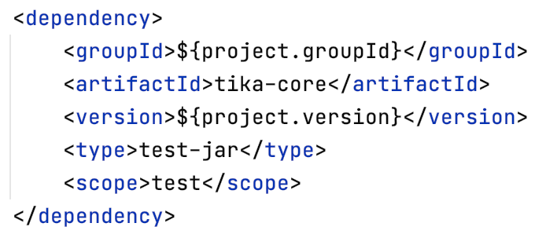
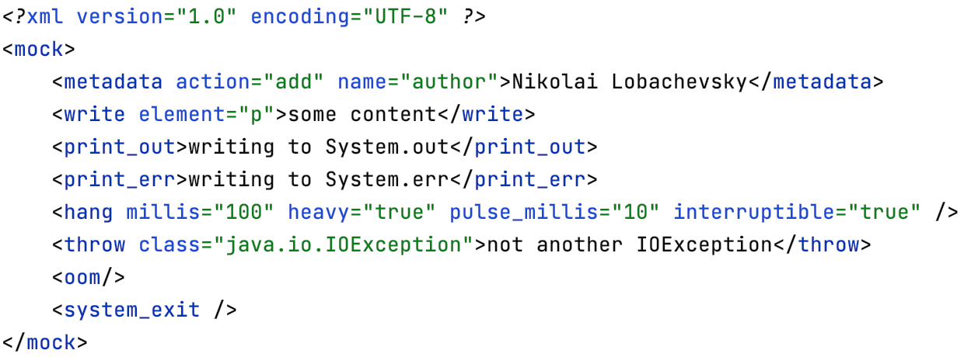
MockParser: Mock a misbehaving parser
Add tika-core’s test-jar to your path and specify mayhem
Now with FakeLoad
https://github.com/msigwart/fakeload

Slide 32
Some options to avoid catastrophe
ForkParser
tika-batch (-i -o options in tika-app)
tika-server ¯\_(ツ)_/¯
In 2.x: PipesParser
tika-app: -a (async option)
tika-server: /pipes and /async handler
See: https://wiki.apache.org/confluence/display/TIKA/The+Robustness+of+Apache+Tika

Slide 33
Evolution of tika-server
© 2021 California Institute of Technology. Government sponsorship acknowledged.

Slide 34



In the beginning
Noticeable
Crashes
Hidden
Infinite loops
Slow building memory leaks
Out of Memory errors
JVM Boundary

Slide 35

--spawnChild (default in Tika 2.x)
Crashes (restart)
Infinite loops (timeout and restart)
Out of Memory errors (restart)
Slow building memory leaks (restart after X files)
JVM Boundary

Slide 36
tika-pipes module
© 2021 California Institute of Technology. Government sponsorship acknowledged.

Slide 37
Goals
Isolate parsing into its own process
Keep iterator/command module in separate process
Keep parsing out of indexing processes
Allow for robust timeouts
Allow for long, long parse times, e.g. OCR on 100 page PDF

Slide 38
Fetchers/emitters
Configured in tika-config.xml file
Fetcher – grab an inputstream and metadata from source, e.g. s3://mybucket/path/to/my_file.pdf
Emitter – after parsing the file, forward it to, e.g. Solr or Opensearch
Client only sends ids (not data)
Potentially put Tika processors closer to the data
Skip return trip
https://issues.apache.org/jira/browse/TIKA-3226

Slide 39
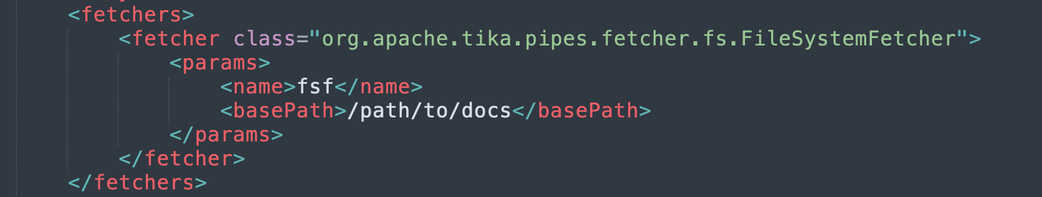
Fetchers
File system, http, S3, GCS… others?

Slide 40
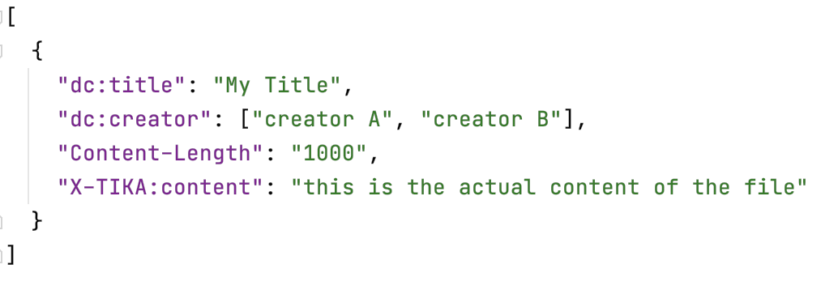
Parse -> extract
Content may be xhtml or plain text

Slide 41
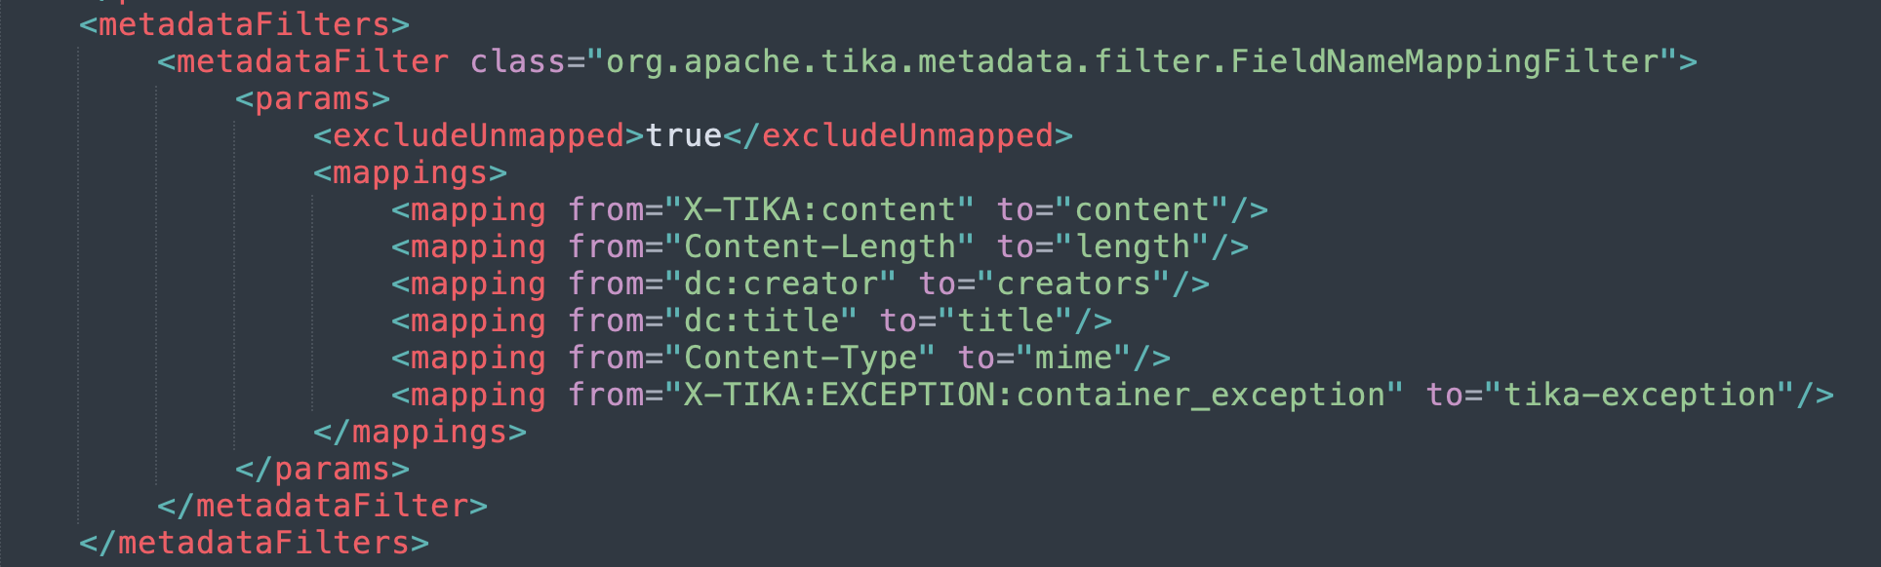
Metadata Filters

Slide 42
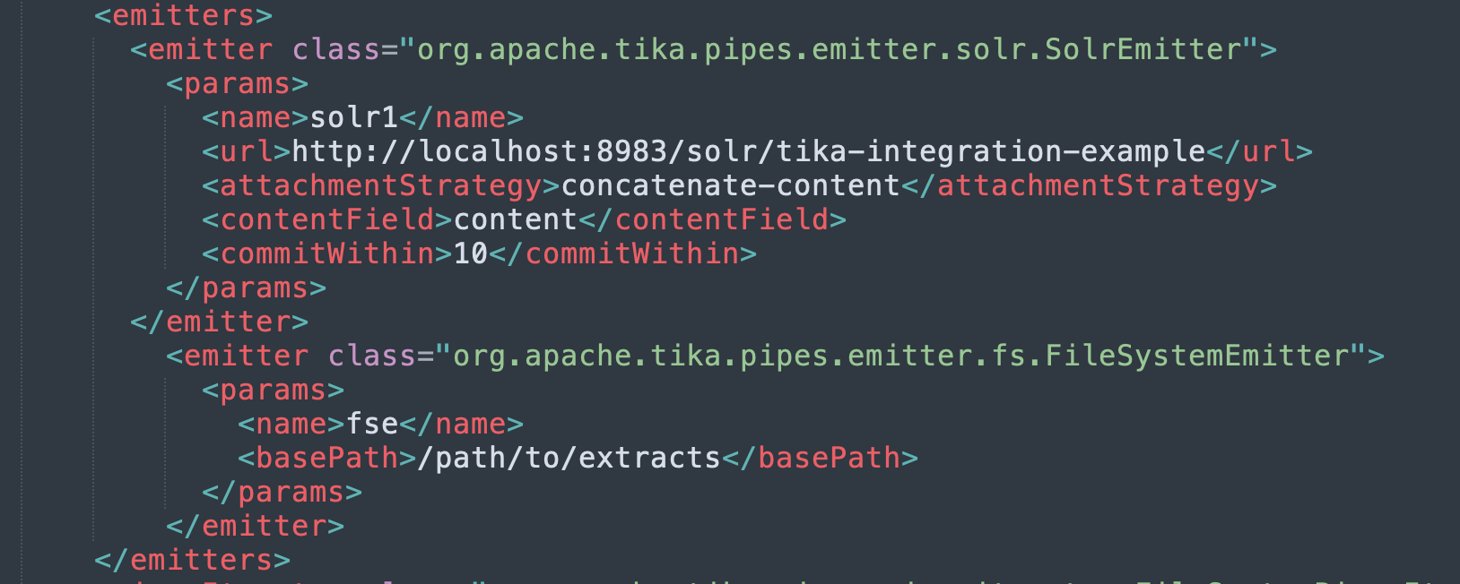
Emitters
After the parse, send the data to…S3, Solr, OpenSearch…

Slide 43
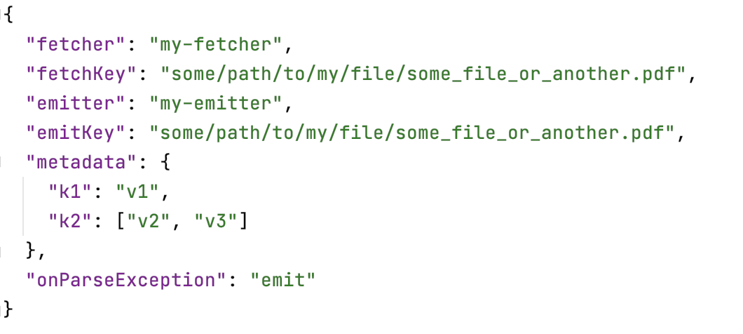
Example FetchEmitTuple

Slide 44
New endpoints in tika-server: /pipes, /async
/pipes is /rmeta but fetches, emits and returns status value
/async is /pipes, but it adds a list of FetchEmitTuples to a queue

Slide 45
Fetchers/Emitters
Fetchers
FileShare
URL/http
S3
Solr
GCS
Emitters
FileShare
S3
Solr
OpenSearch

Slide 46



Fetchers/emitters: Process isolation per parse
json
json
json
© 2021 Apache Software Foundation
bytes
JVM Boundary
© 2021 Amazon Web Services

Slide 47
Fetchers/emitters: Process isolation per parse
json
json
json
© 2021 Apache Software Foundation
bytes
JVM Boundary
© 2021 Amazon Web Services

Slide 48
Current state An example with Amazon S3 -> Solr
bytes
text
Client
© 2021 Apache Software Foundation
…
© 2021 Amazon Web Services

Slide 49
Fetchers/emitters: Scaling across a cluster
json
json
…
json
Client
© 2021 Apache Software Foundation
© 2021 Amazon Web Services

Slide 50
Emitters – batching emits…deep dive
json extracts [ ]
Emit Cache
json parse request
json extract
© 2021 Apache Software Foundation
bytes
JVM Boundary
© 2021 Amazon Web Services

Slide 51
Emitters – batching emits…deep dive
json extracts [ ]
Emit Cache
json extracts
© 2021 Apache Software Foundation
JVM Boundary
© 2021 Amazon Web Services

Slide 52
Emitters – batching emits, unless…
Emit Cache
json parse request
© 2021 Apache Software Foundation
json extract
bytes
JVM Boundary
© 2021 Amazon Web Services

Slide 53
Emitters – parameters and requirements
Emitter dependencies must be loaded in both the main tika process (server or app) and in the async pipes processor
Parameters

Slide 54
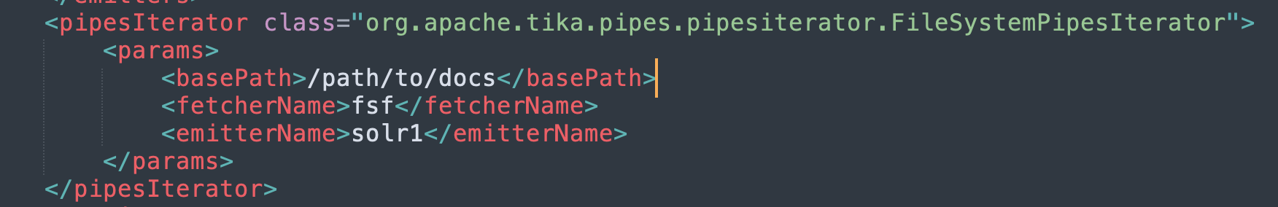
AsyncClient and PipesIterators

Slide 55
TODO
More integration tests, esp. w Dockerized/Mocked S3, Solr, OpenSearch
More performance tests
Improve packaging of jars for tika-server
Infinidash™ integration
Documentation

Slide 56
Please join the fun!
https://tika.apache.org/
https://cwiki.apache.org/confluence/display/TIKA/TikaEval
corpora-dev@tika.apache.org
https://issues.apache.org/jira/projects/TIKA
@ApacheTika

Slide 57
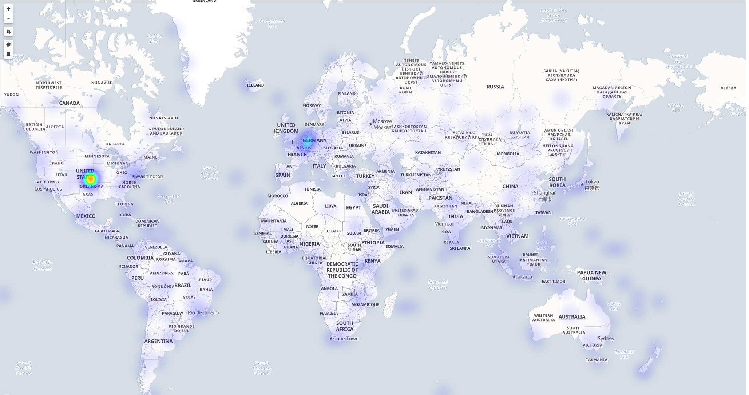
If you love files…
8 million PDFs (10 TB) from Common Crawl CC-MAIN-2021-31
https://www.pdfa.org/presentation/making-sense-of-pdf-structures-in-the-wild-at-scale/
PDF Association’s PDF Days, next Wednesday, free and online!

Slide 58
Questions?
timothy.b.allison@jpl.nasa.gov @_tallison

Slide 59
© 2021 California Institute of Technology. Government sponsorship acknowledged.

